Slide 1
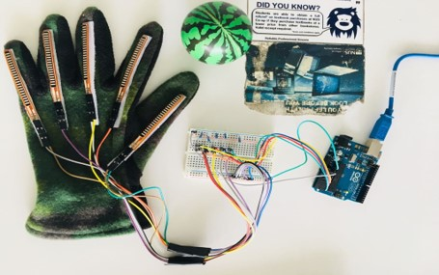
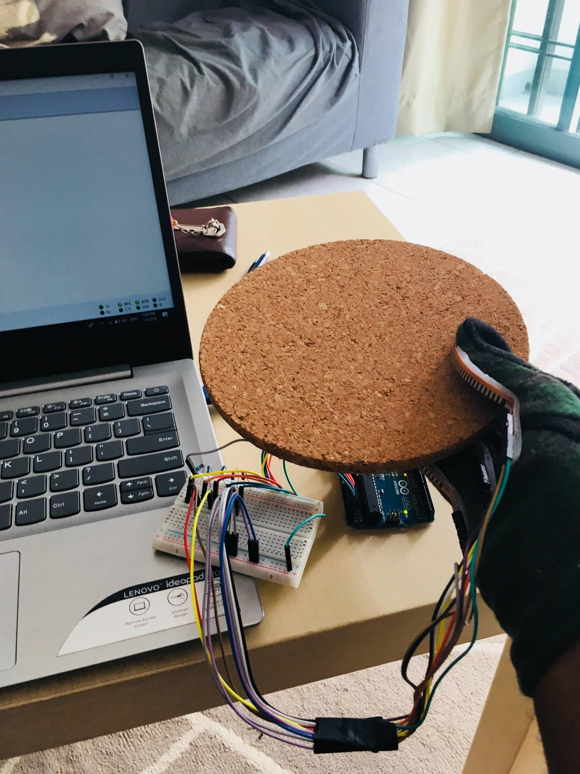
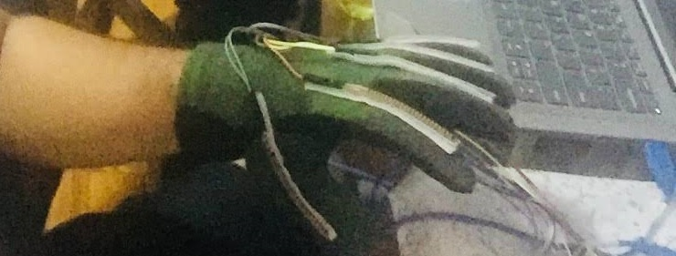
Soft Robotic Hand
Sriraj Thammana A0178317X
Surbhi Tayal A0178376M

Slide 2
Background of the project
Soft Robotic Hand for object recognition (shape recognition).
2-D recognition already in place.
3-D shape recognition by the degree of bend of the flex sensors.

Slide 3
Approach
Flex sensor measures amount of deflection or bending.
As the sensor is flexed, amount of resistance increase and hence voltage drops.
Voltage change varies as per bending of flex sensors and is different for different objects.
Typical resistance values:
Straight (unflexed) resistance: ~9000 Ohm
90 degree bend resistance: ~14000 Ohm
180 degree bend resistance : ~22000 Ohm
To collect data, first read the voltage value through ‘Coolterm’.
To have a significant change in voltage value, we try out with different resistance values for the circuit.
For our data set, resistance value is 65 Kilo ohm.

Slide 4
Challenges and Data Collection
Research/literature reviews are not extensively available for this project.
No data set available online.
As data sets are NOT available, we identified objects of different shape and collected data from different people with and without filtering.
Objects | No. Of Persons | Time (in Sec)
Circle (Gripper ball) | 10 | 20
Square (Marker) | 10 | 20
Rectangle (Notebook) | 10 | 20
Laptop mouse | 10 | 20
Circular tape | 10 | 20
Note*: Above table represents data collection without filtering (raw data).

Slide 5
Data cleanup
Data is improper in some files due to loose connection of sensors with the glove.
Few data has been collected again and improper data is replaced with the values in corresponding rows.
Cleaned the data for missing values
Number of rows is kept consistent in all the files.

Slide 6
Normalization and Histogram
.
We performed Min-max normalization on our data in range of 0 to 1 as our features do not have a uniform scale.
Normalization graphs for different objects collected for different persons is shown in next slides.

Slide 7
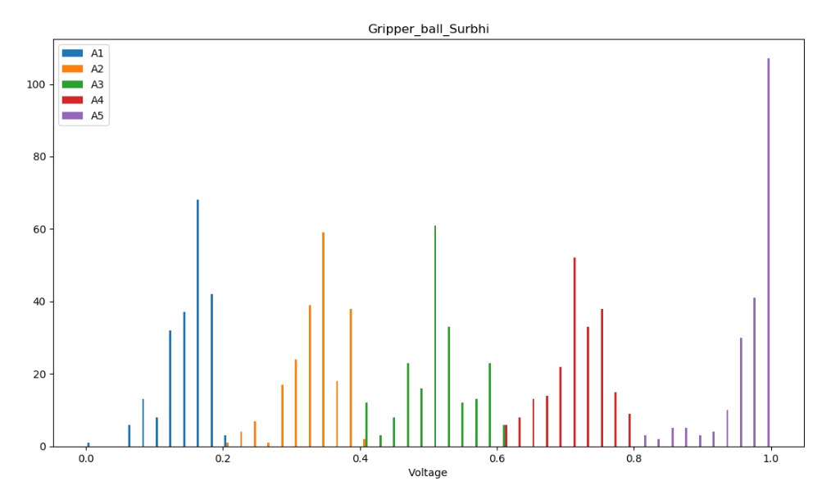
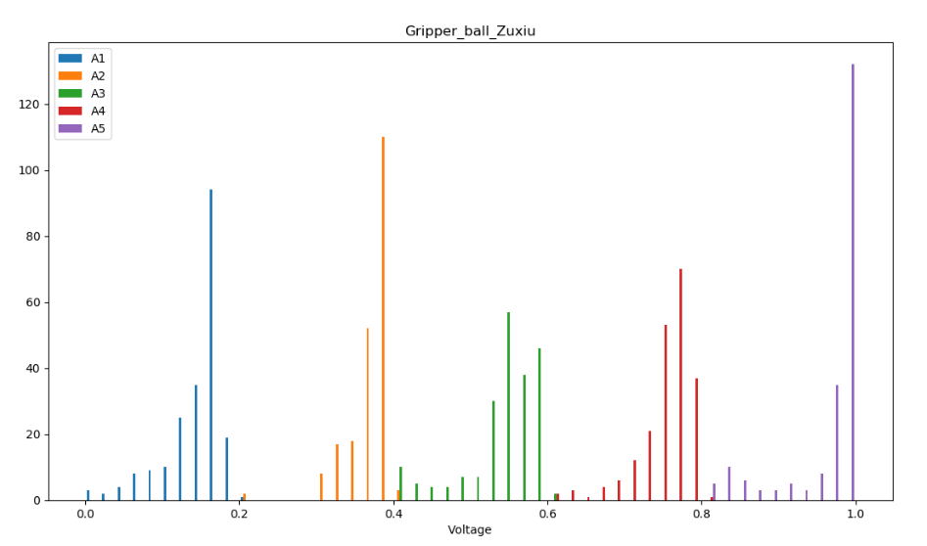
Data comparison
Histogram for object Gripper Ball for 2 subjects

Slide 8
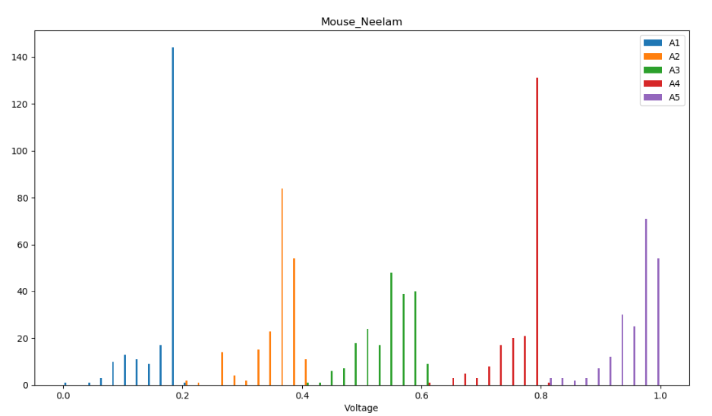
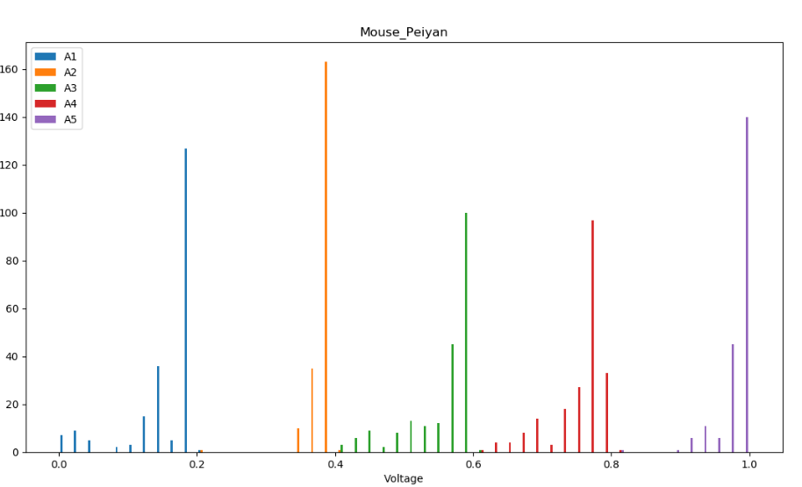
Histogram for object Mouse for 2 subjects

Slide 9
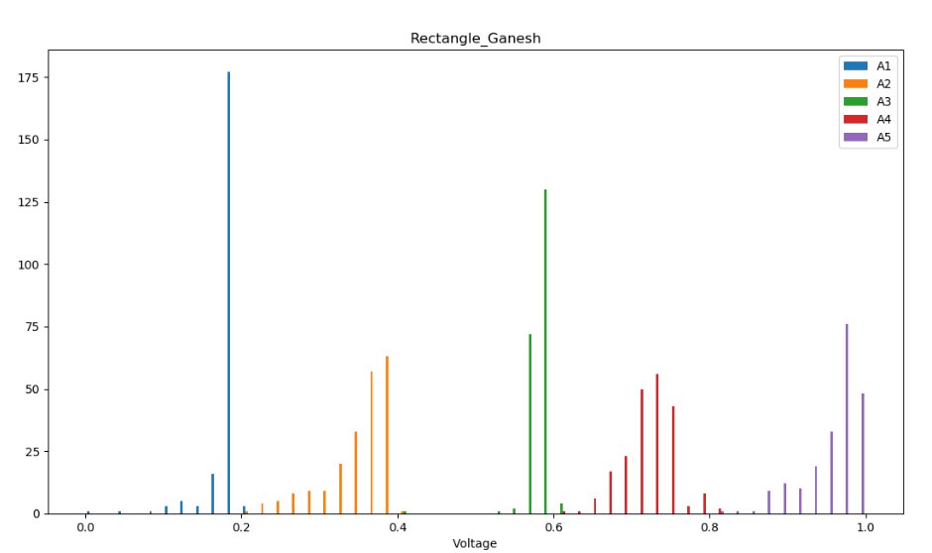
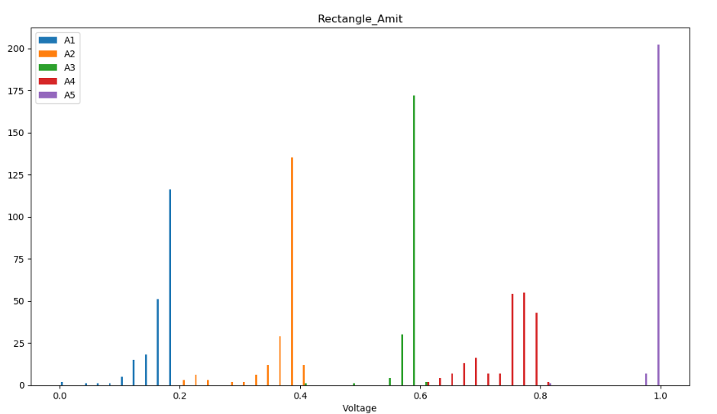
Histogram for object Rectangle for 2 subjects

Slide 10
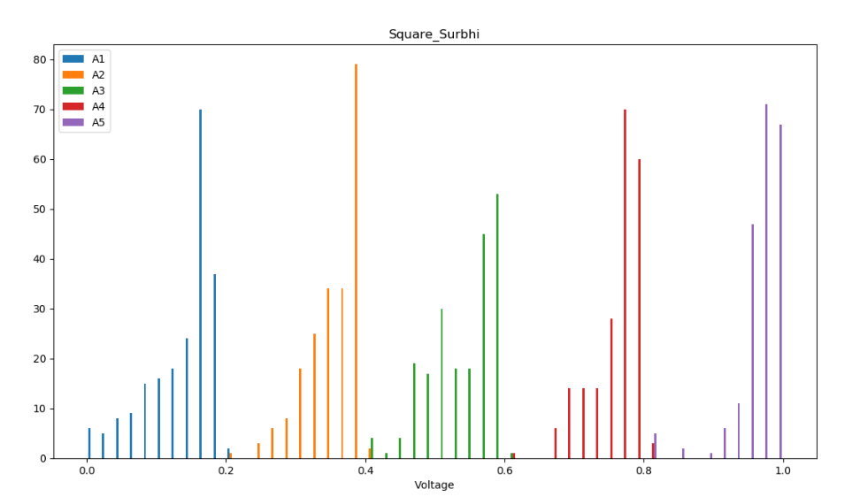
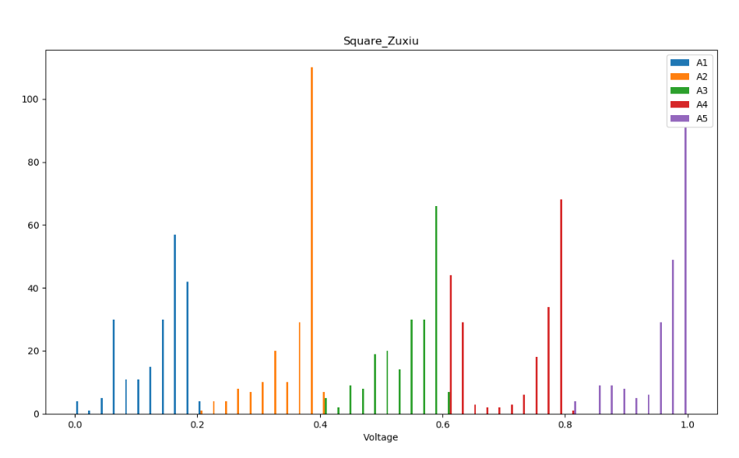
Histogram for object Square for 2 subjects

Slide 11
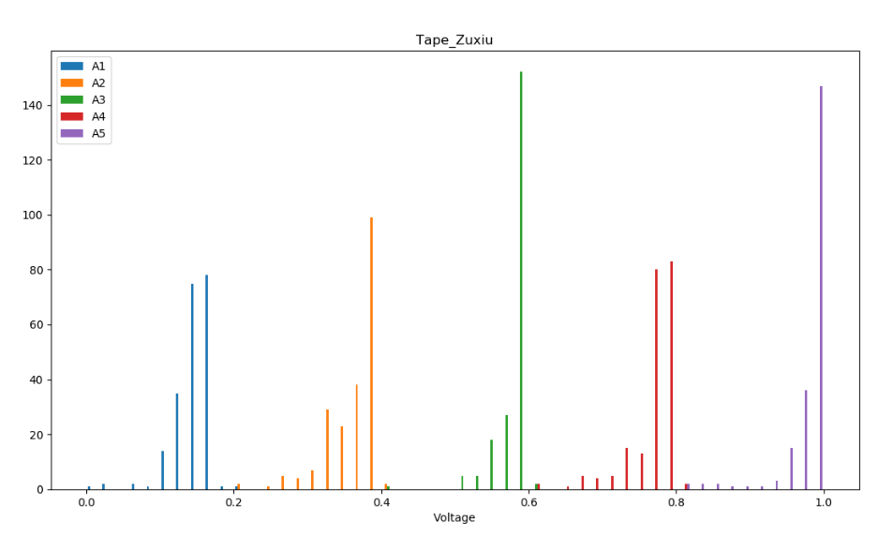
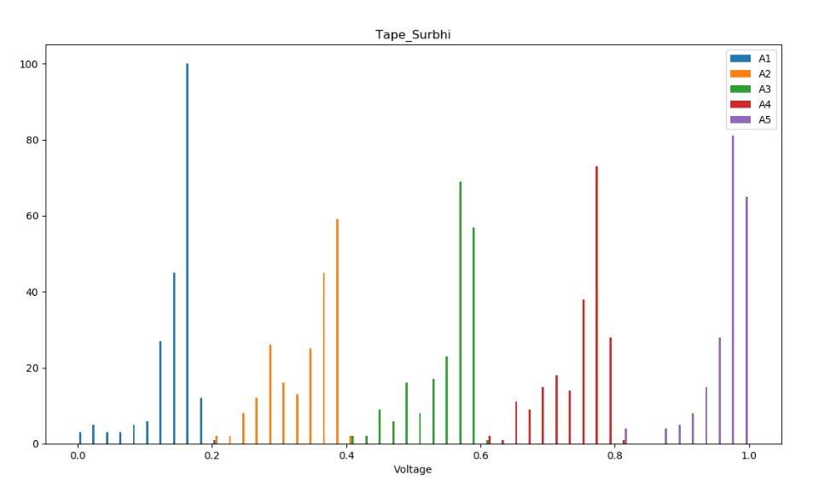
Histogram for object Tape for 2 subjects

Slide 12
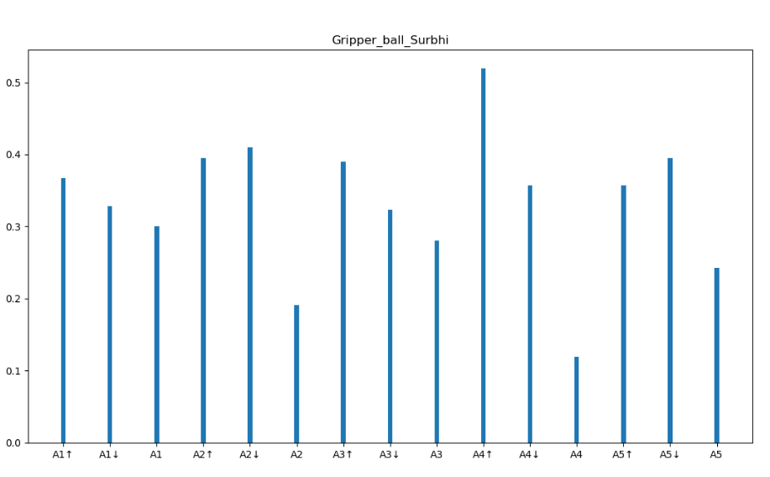
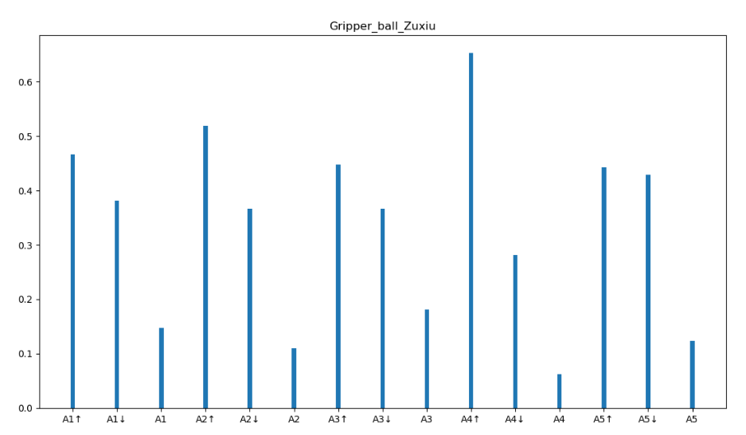
Data comparison
Change in value as compared to previous value for each column
Histogram for Trend of value change for Gripper ball for 2 subjects

Slide 13
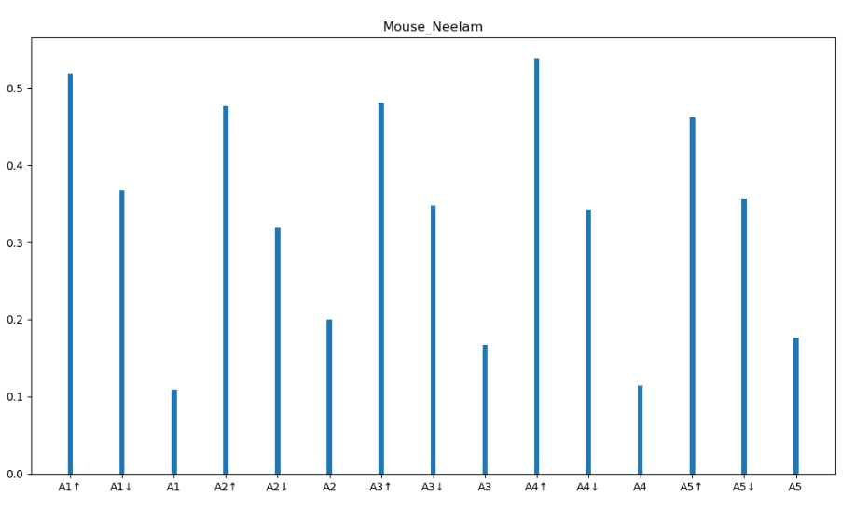
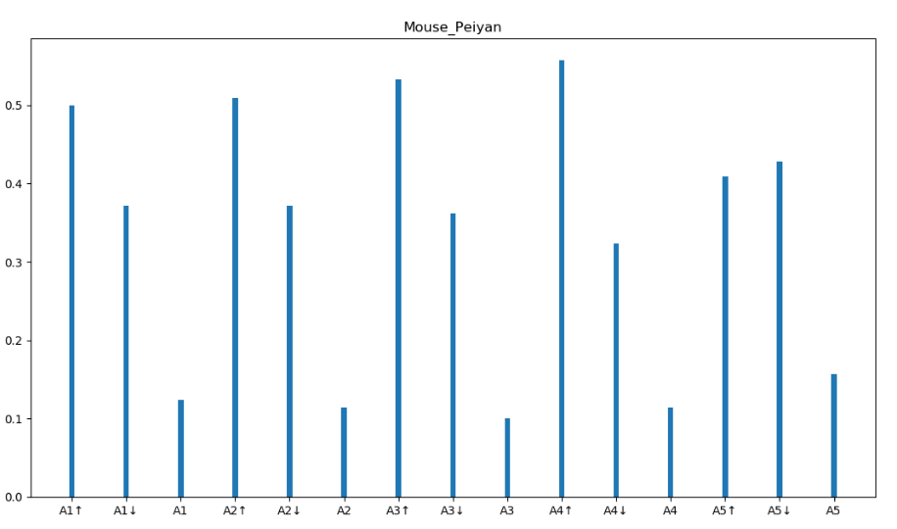
Histogram for Trend of value change for Mouse for 2 subjects

Slide 14
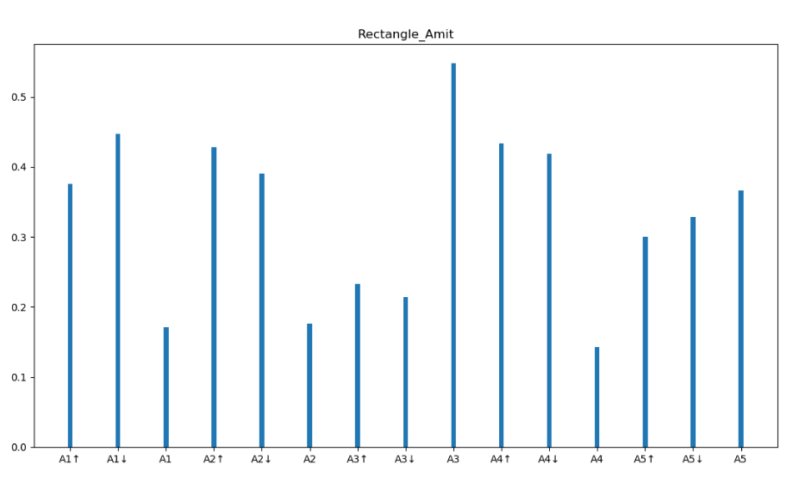
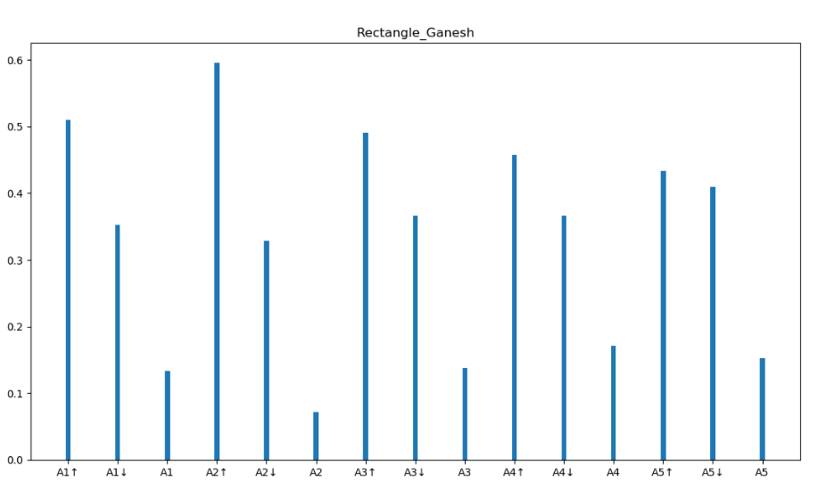
Histogram for Trend of value change for Rectangle for 2 subjects

Slide 15
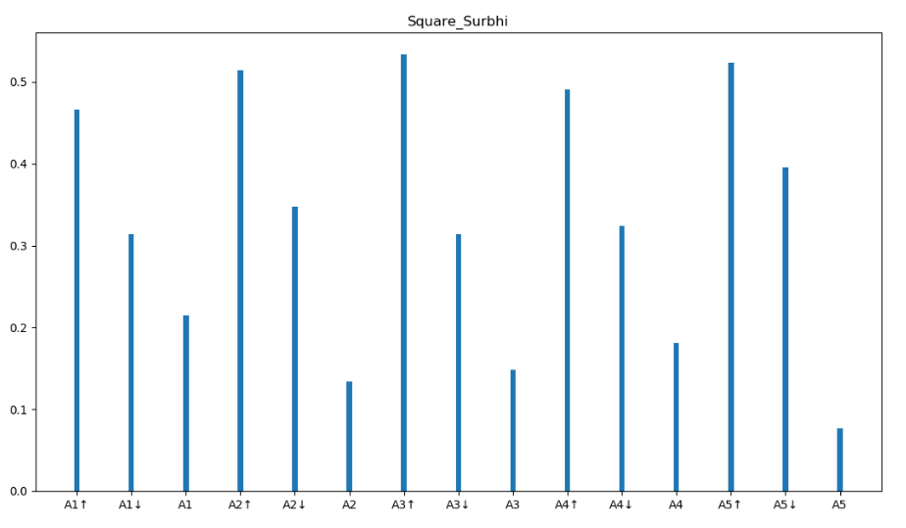
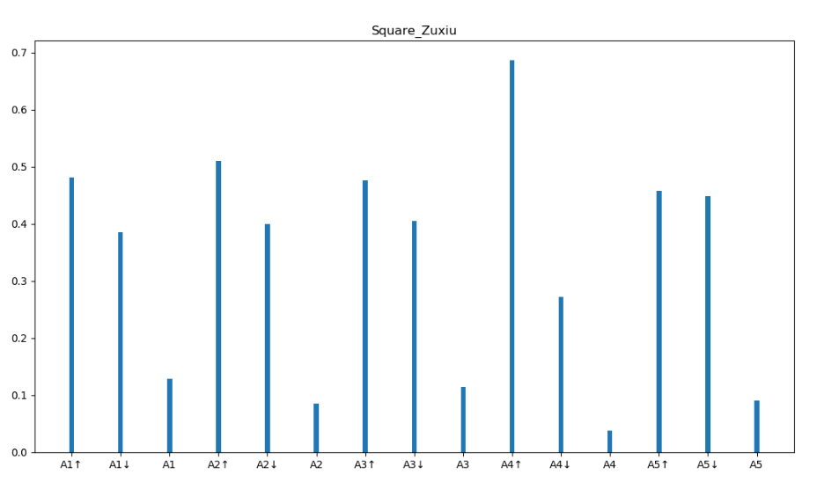
Histogram for Trend of value change for Square for 2 subjects

Slide 16
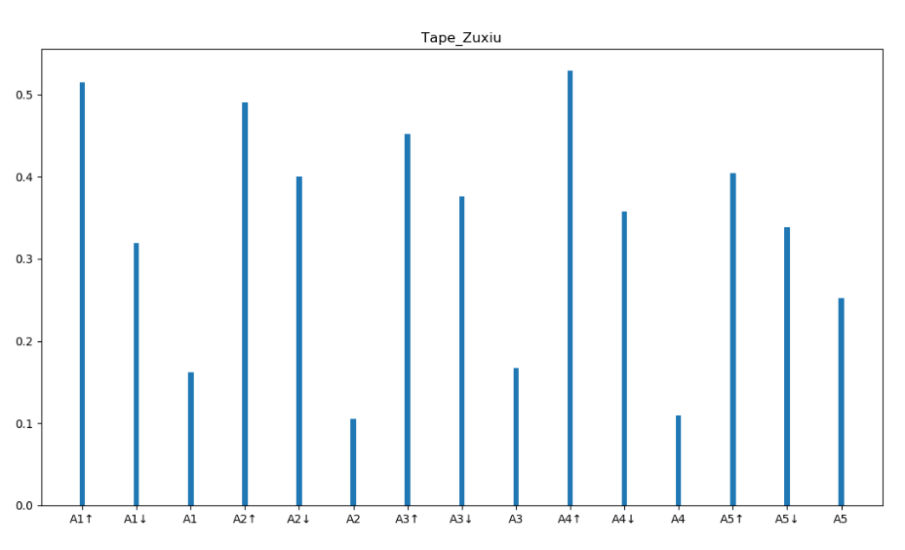
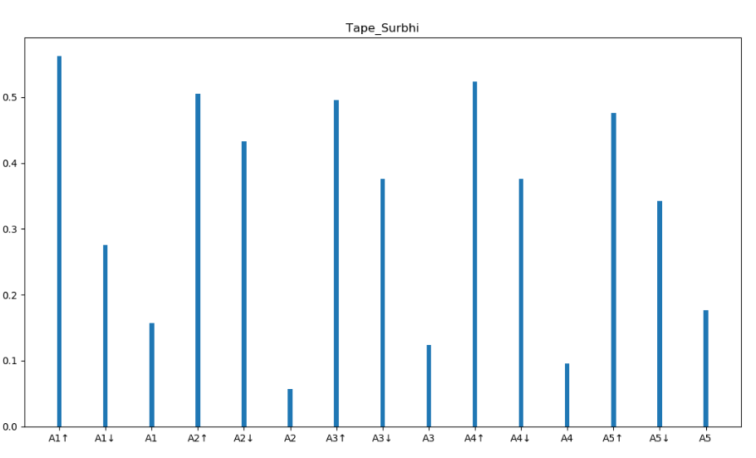
Histogram for Trend of value change for Tape for 2 subjects

Slide 17
Binary classification algorithms
Below are the results after applying three algorithms to train the model.
Models are trained in the ratio of 60:40 i.e. train:test
Accuracy and Precision | Objects | SVM | KNN | Neural Network
 | Mouse vs Rectangle | 0.764 0.705 | 0.918 0.909 | 0.772 0.726
 | Mouse vs Square | 0.589 0.636 | 0.848 0.863 | 0.667 0.648
 | Mouse vs Tape | 0.918 0.897 | 0.977 0.963 | 0.921 0.918
 | Square vs Tape | 0.880 0.863 | 0.978 0.964 | 0.884 0.879
 | Square vs Rectangle | 0.709 0.656 | 0.917 0.897 | 0.745 0.711
 | Rectangle vs Tape | 0.931 0.914 | 0.978 0.972 | 0.964 0.946

Slide 18
Future Scope
Research can be extended further in this domain by collecting more data for different objects of different shapes.
Classification can be done according to various features like age group, data handling, actions performed, etc.
Comparison between more than 2 objects can also be captured.
Further deep learning models can be implemented with high amount of data.

Slide 19
Thank You !

